Slide 1

Employee Data Analysis using Excel
STUDENT NA ME: HEMASRI DJ
REGI STER NO: 312210958, asunm1423312210958
DEPA RTMENT : DEPA RTMENT OF COMMERCE
{B.COM[ACCOUNTING AND FINANCE]
COLLEGE:DR.MGR JANAKI COLLEGE OF ARTS AND SCIENCE
FOR WOMEN .
1

Slide 2

PROJECT TITLE
Employee Performance A nalysis
using Excel
2

Slide 3

AGENDA
1.Project Overview
2.Probl em Statement
3.End Users
4.Our Solution and Proposition
5.Dataset Descripti on
6.Modell ing A pproach
7.Results and Discussion
8.Concl usi on
3

Slide 4

PROBLEM STATEMENT
1. IDENTIFY ING STRENGTHS AND WEAK NESSES: Understand individual skills and areas for
i mpr ovement.
2. SETTING GOALS AND EXPECTATIONS: Establish clear objectives and targets.
3. EVALUATING J OB FIT: Determine if employees are suited for their roles.
4. DEVELOPMENT AND GROWTH: Create training plans and opportunities for advancement.
5. PERFORMANCE IMPROV EMENT: Address underperformance and provide support.
6. FAIR COMPENSATIONA ND REWARDS: Base salary and benefits on performance
7. SUCCESSI ON PL ANNING: Identify future leaders and key players.
8. ENHANCING EMPLOY EE ENGAGEMENT: Recognize and value contributions.
9. STRATEGIC DECISION-MAKING: Inform business decisions with data-driven insights.
REGULAR ANALY SIS HELPS EMPLOY EES GROW, IMPROVES ORGANIZATIONAL
EFFICI ENCY, AND DRIVES BUSINESS SUCCESS.
4

Slide 5

PROJECT OVERVIEW
The Employee Performance Analysis project aims to enhance employee
performance and business success through data-driven insights. The project will
collect relevant data, establish clear performance metrics, conduct statistical
•.
analysis, and present findings and recommendations to stakeholders. The scope
includes i dentifying strengths, weaknesses, opportunities, and threats, and
implementing actions to address performance gaps, develop traini ng programs, and
enhance employee engagement. The project will deliver a comprehensive analysis
report, actionable recommendations, customized training plans, and an enhanced
performance evaluation framework. With a timeline of [insert timeline], the proj ect
will involve HR, management, department heads, and employees, and will benefi t
the organization through data- driven decision- making, improved employee
engagement and productivity, and increased business efficiency and success.
5

Slide 6

WHO ARE THE END USERS?
❑ EMPLOY ER
❑ EMPLOY EE
❑ ORGA NISATION
❑ IT SECTORS
❑ BUSINESS FIRM
❑ COMPA NY
6

Slide 7

OUR SOLUTION AND ITS VALUE PROPOSITION
CONDITIONAL FORMATTING:IT IS USED TO FIND OUT THE
BLANK VALUES.
FI LT ERING: IT IS USED TO FILTER OUT THE BLANK VA L UES
FROM THE DATA.
PI VOT TABL E: PIVOT TABLE IS USED TO SUMMARIZES,
ORGNAIZES AND ANALY ZES THE DATA INA TABLE.
CHART:A CHART IS USED TO VISUALLY REPRESENT THE
DATA AND HELP US TO SEE PATTERNSAND TRENDS IN OUR
DATA .
7

Slide 8

Dataset Description
❖ EMPLOY EE DATA SET– KA GGLE
❖ 26 FEATURE
❖ FEAT URE- 9 FEATURE
❖ EMPLOY EE ID- CATEGORICAL DATA
❖ GENDER- MA LE,FEMA LE
❖ PERFORMANCE LEVEL-ORDINAL DATA
❖ BUSINESS UNIT-REFERENCE DATA SET
❖ NAME-NOMINAL DATA
❖ RATING- NUMERICA L VA LUE

Slide 9

THE "WOW" IN OUR SOLUTION
• CONDI TI ONAL FORMATTING:BY USING THIS
BLA NK CELLS WERE FOUND AND HIGHLIGHTED.
• FILT ER: BY USING THIS FILTER THE BLANK VA LUES
WERE REMOV ED.
• FORMUL A USED TO I DENTI FY PERFORMA NCE
L EVEL: IFS
EG: = IFS(Z8>=5,“ VERY
HIGH”,Z8>=4,“HIGH”,Z8>=3,“MEDIUM”,TRUE,“LOW”)
3/21/2024 Annual Review
9

Slide 10

MODELLING
DATA COLLECTION: KAGGLE WAS THE SOURCE WHICH WAS USED TO COLLECT DATA.ALMOST 26 FEATURE WAS
COLLECTED AND 9 FEATURES WERE USED IN EXCEL.
SOME OF THE FEATURE WAS EMPLOY EE ID,FIRST NAME,CREDIT RATING.
DATA CLEANING: THE COLLECTED DATA WAS CLEANED AND FILTERED USING CONDITIONAL FORMATTING A ND
FILTER .
T EC HNI QUES:
• CONDITIONAL FORMATTING:BY USING THIS BLANK CELLS WERE FOUND AND HIGHLIGHTED.
• FI LT ER: BY USING THIS FILTER THE BLANK VALUES WERE REMOVED.
R ESULT S: THE RESULT WAS CALCULATED ON THE BASIS OF PERFORMANCE OF THE EMPLOY EE
PI VOT TABLE:THE PIVOT TABLE WAS DONE USING THE FOLLOWING:-
✓ FI LTER:GENDER CODE
✓ COL UMNS:PERFORMA NCE LEV EL
✓ ROWS:BUSINESS UNIT
✓ VA LUES:C OUNT OF FIRST NA MES.
CHA RT:THE CHART CHOOSEN FOR THE ABOVE DATA IS BAR GRAPH
BY USING TREND LINE ,THE LINEAR WAS SET AT VERY HIGH VALUE AND EXPONENTIAL WAS SET UPAT LOW VALUE.
10

Slide 11
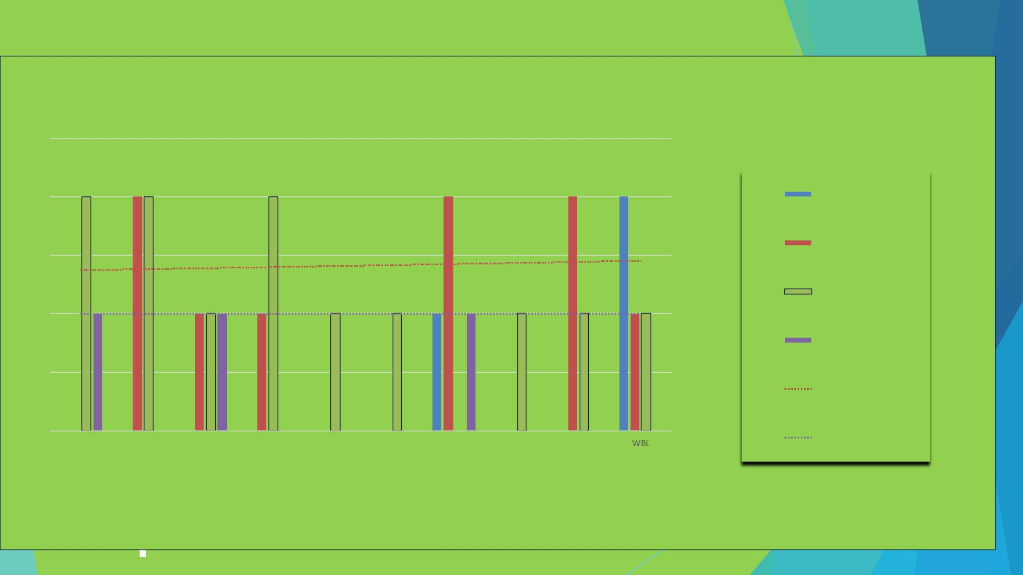
RESULTS
EMPLOYEE PERFORMANCE ANALYSIS
2.5
2
HI GH
LOW
1.5
1
MEDIUM
VERY HIGH
Expon. (LOW)
Linear (VERY HIGH)
0.5
0
BPC
CCDR
EW
MSC
NEL
PL
PYZ
SVG
TNS
11

Slide 12

concl usi on
In conclusion, the Employee Performance Analysis project has provided valuable insights into
the strengths, weaknesses, opportunities, and threats within our organization. By analyzing
employee performance data, we have identified areas for improvement, optimized performance
metrics, and developed targeted training and development programs. This project will empo wer
the organization to make data- driven decisions, enhance employee engagement and productivity,
and drive business growth. Ultimately, this project has set a new standard for employee
performance management, positioning the organization for continued excellence and
competitiveness in the industry

